Slide 1

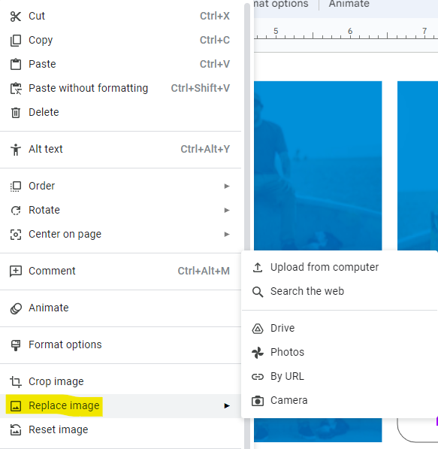


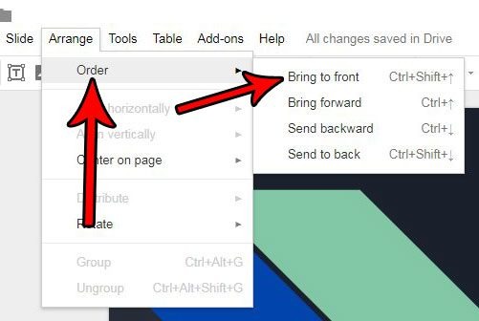
Right-click on an image that is closest to the orientation of the image you wish to upload, then select “Replace image” to replace the image with an image uploaded from your device. You need only submit one picture.

